Slide 1

Chris Woodruff
LearningAbout.Dev
Level: Intermediate, etc.

Slide 2

Your first ASP.NET 5 Web API
Learn to Produce Effective Web APIs with ASP.NET 5

Slide 3
What do you and I do wrong?
ASP.NET Core Web API Architecture

Slide 4
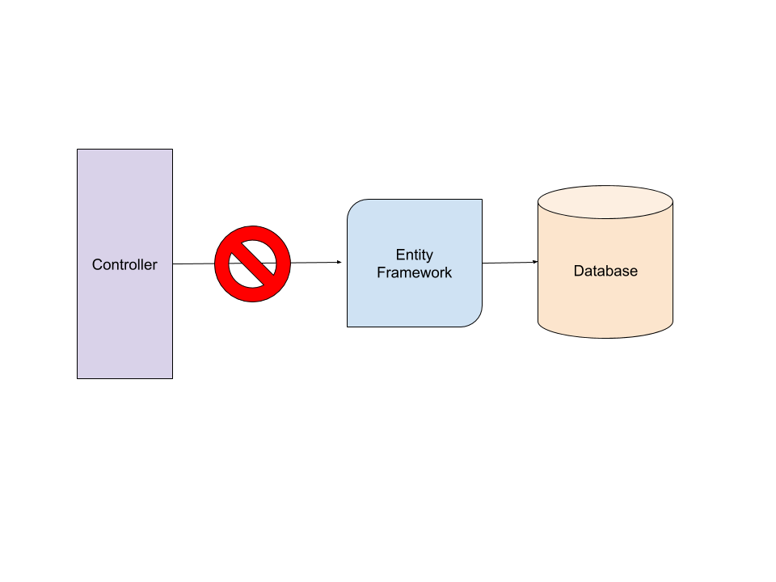
Bad Habits
Calling Data Access functionality (EF Core) from Controllers

Slide 5

Bad Habits
Having all code in a single project. Hard to test!

Slide 6

Bad Habits
Coupling your Data Access (EF Core) to your project Domain

Slide 7

Bad Habits
Not thinking about Unit or Integration testing

